Slide 1

SEAMK
International, entrepreneurial SeAMK – The best university for you

Slide 2
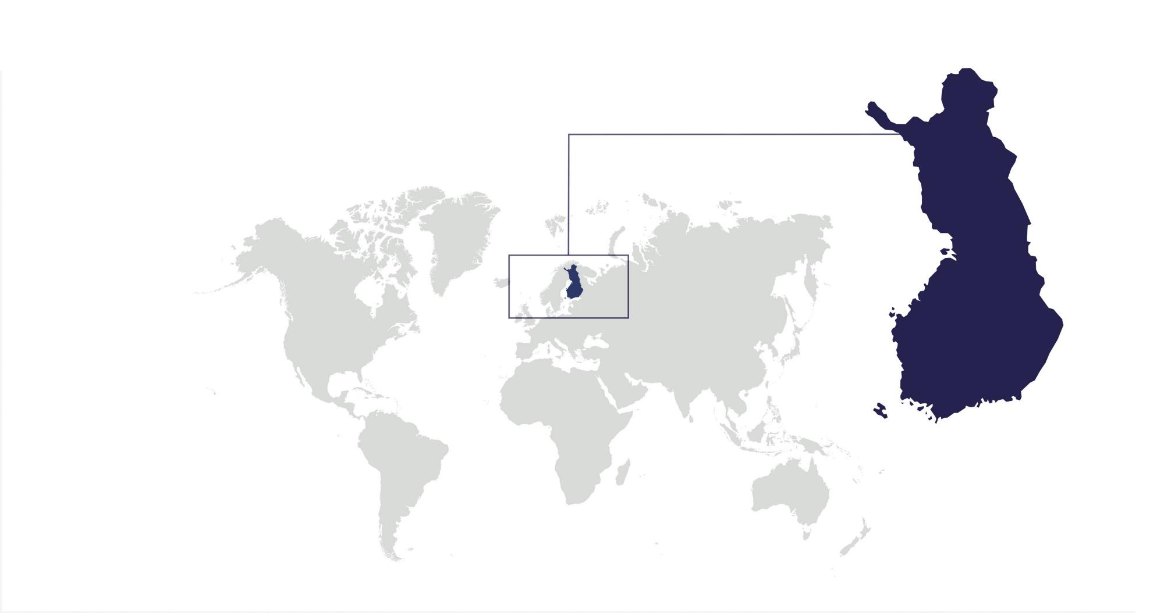
Finland on a map
Finland

Slide 3
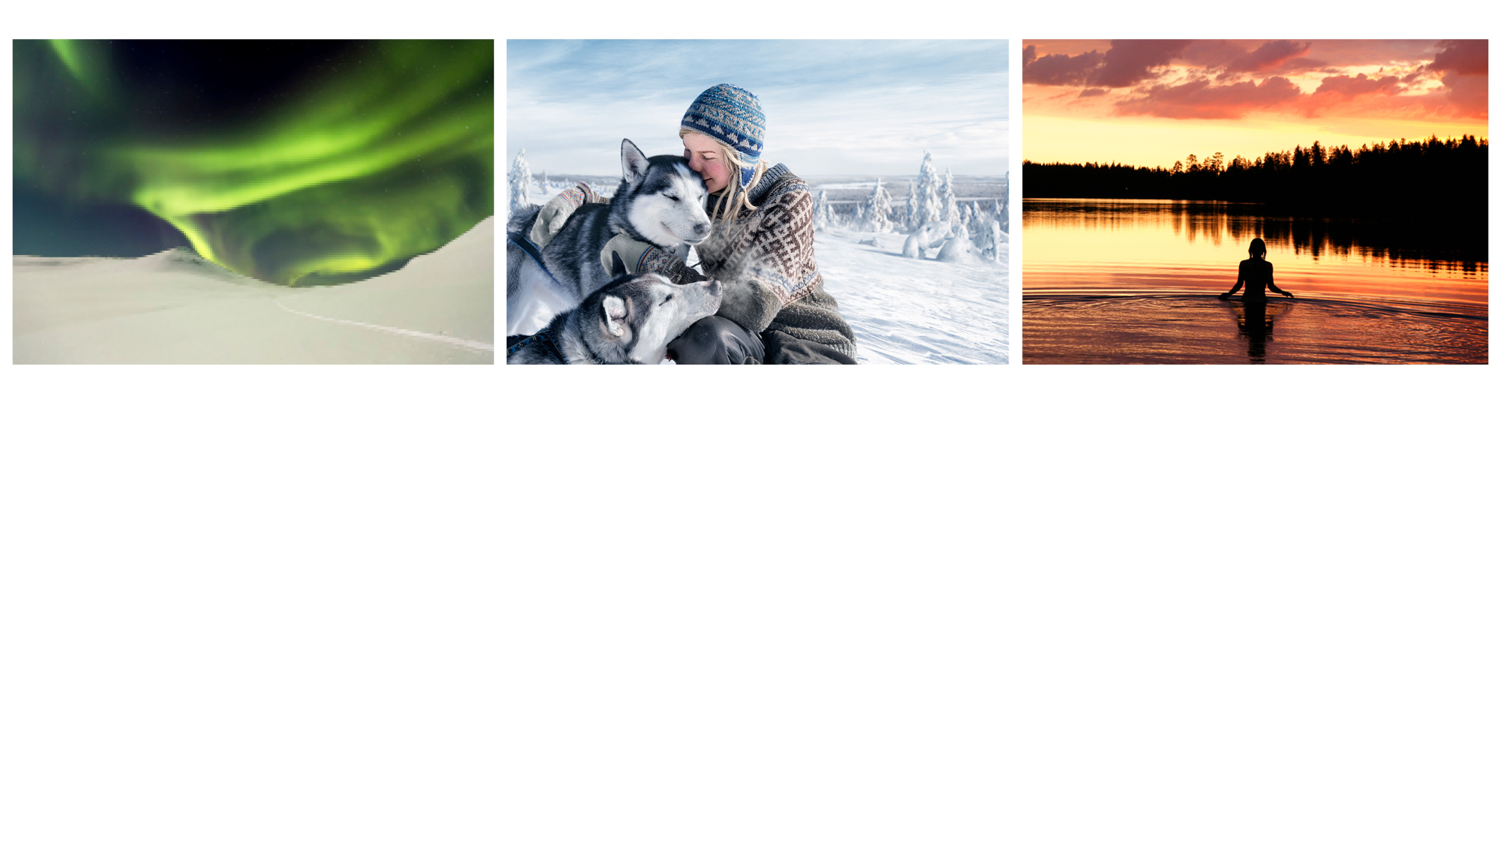
Facts about Finland
Population 5.5 million
18 inhabitants / 2 km²
7th largest country in Europe​
187 888 lakes
Official languages: Finnish (88.9%) and Swedish (5,3%)
​Independent republic since December 6th, 1917 ​
Member of the European Union (EU) since 1995​
Member of the North Atlantic Treat Organization (NATO) since 2023

Slide 4
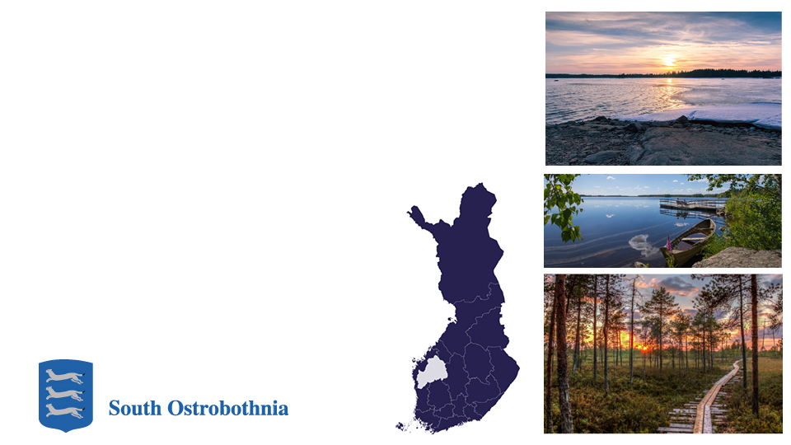
South Ostrobothnia
The Region of South Ostrobothnia is​ located in the Western Finland.
Population: 190 000 ​
Land area: 13 400km²​
Distance between Seinäjoki and Helsinki:
357 km; by train 2 h 35 min, by car 4 hours

Slide 5
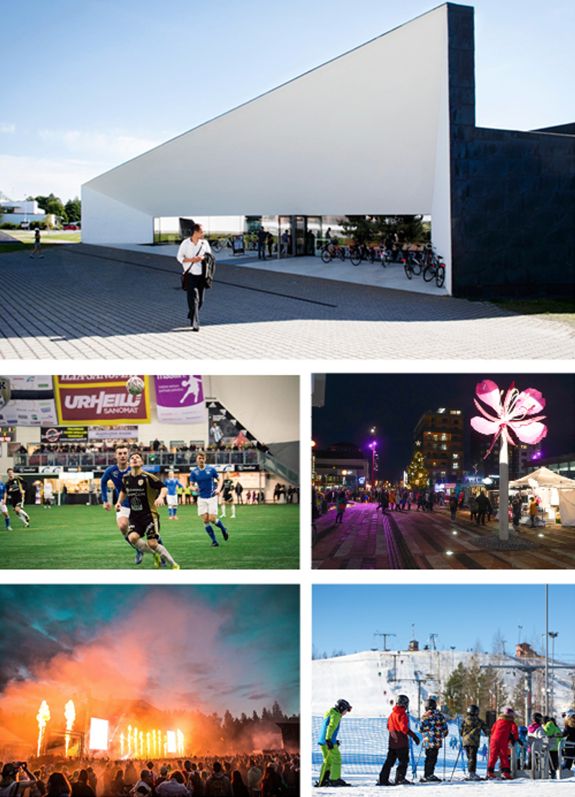
City of Seinäjoki The heart of South Ostrobothnian region
+66 000 inhabitants​.
Rapidly growing city area​. ​
The region is well-known​ for its cultural and​ entrepreneurial atmosphere​. ​
6th largest market region​ in Finland​. ​
One of the most rapidly​ growing urban areas in Finland.

Slide 6

Key lines of business in Seinäjoki
Food processing and technology
​ICT technology​
Retail and services​
​Metal technology​
Wood technology

Slide 7
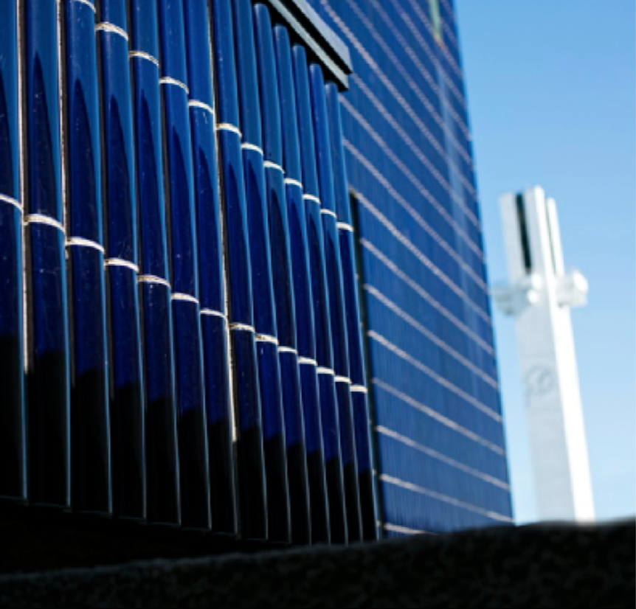
Alvar Aalto Centre
The administrative and cultural​ centre of Seinäjoki is one of the most​ important creations of the famous Finnish architect Alvar Aalto.

Slide 8

The full spectrum of culture
Provinssi is one of the biggest rock festivals in Northern Europe.​
Vauhtiajot – a famous race & rock event​.
Seinäjoki is a popular trade fair, conference​ and congress city.
Seinäjoki Tango Festival (“Tangomarkkinat”)​ is one of the biggest events in Finland with​ more than 100.000 visitors​.

Slide 9
Education system in Finland
Doctor Licentiate
UAS Master’s Degree
(2 year work experience needed)
6
5
5
4
Master’s Degree
3
2
1
4
3
2
1
Bachelor’s Degree
Universities of Applied
Sciences
Bachelor’s Degree
Universities
Vocational school
3
2
1
3
2
1
Upper Secondary
School
10
Basic education
1 2 3 4 5 6 7 8 9
Preschool (at the age of 6 years)

Slide 10
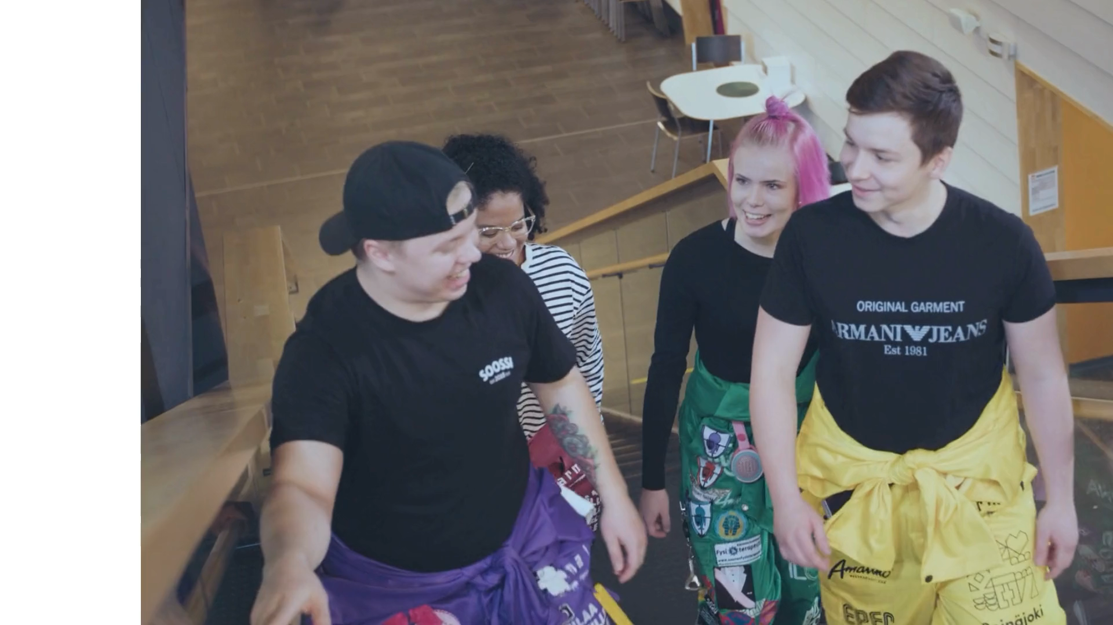

SeAMK facts
approx. 5 000 students​
+800 graduating students annually​
250 international mobility students​
500 international degree students​
+400 employees
Faculties​
Business
Culture​
Food and Hospitality
Health Care and Social Work
Natural Resources
Technology​

Slide 11
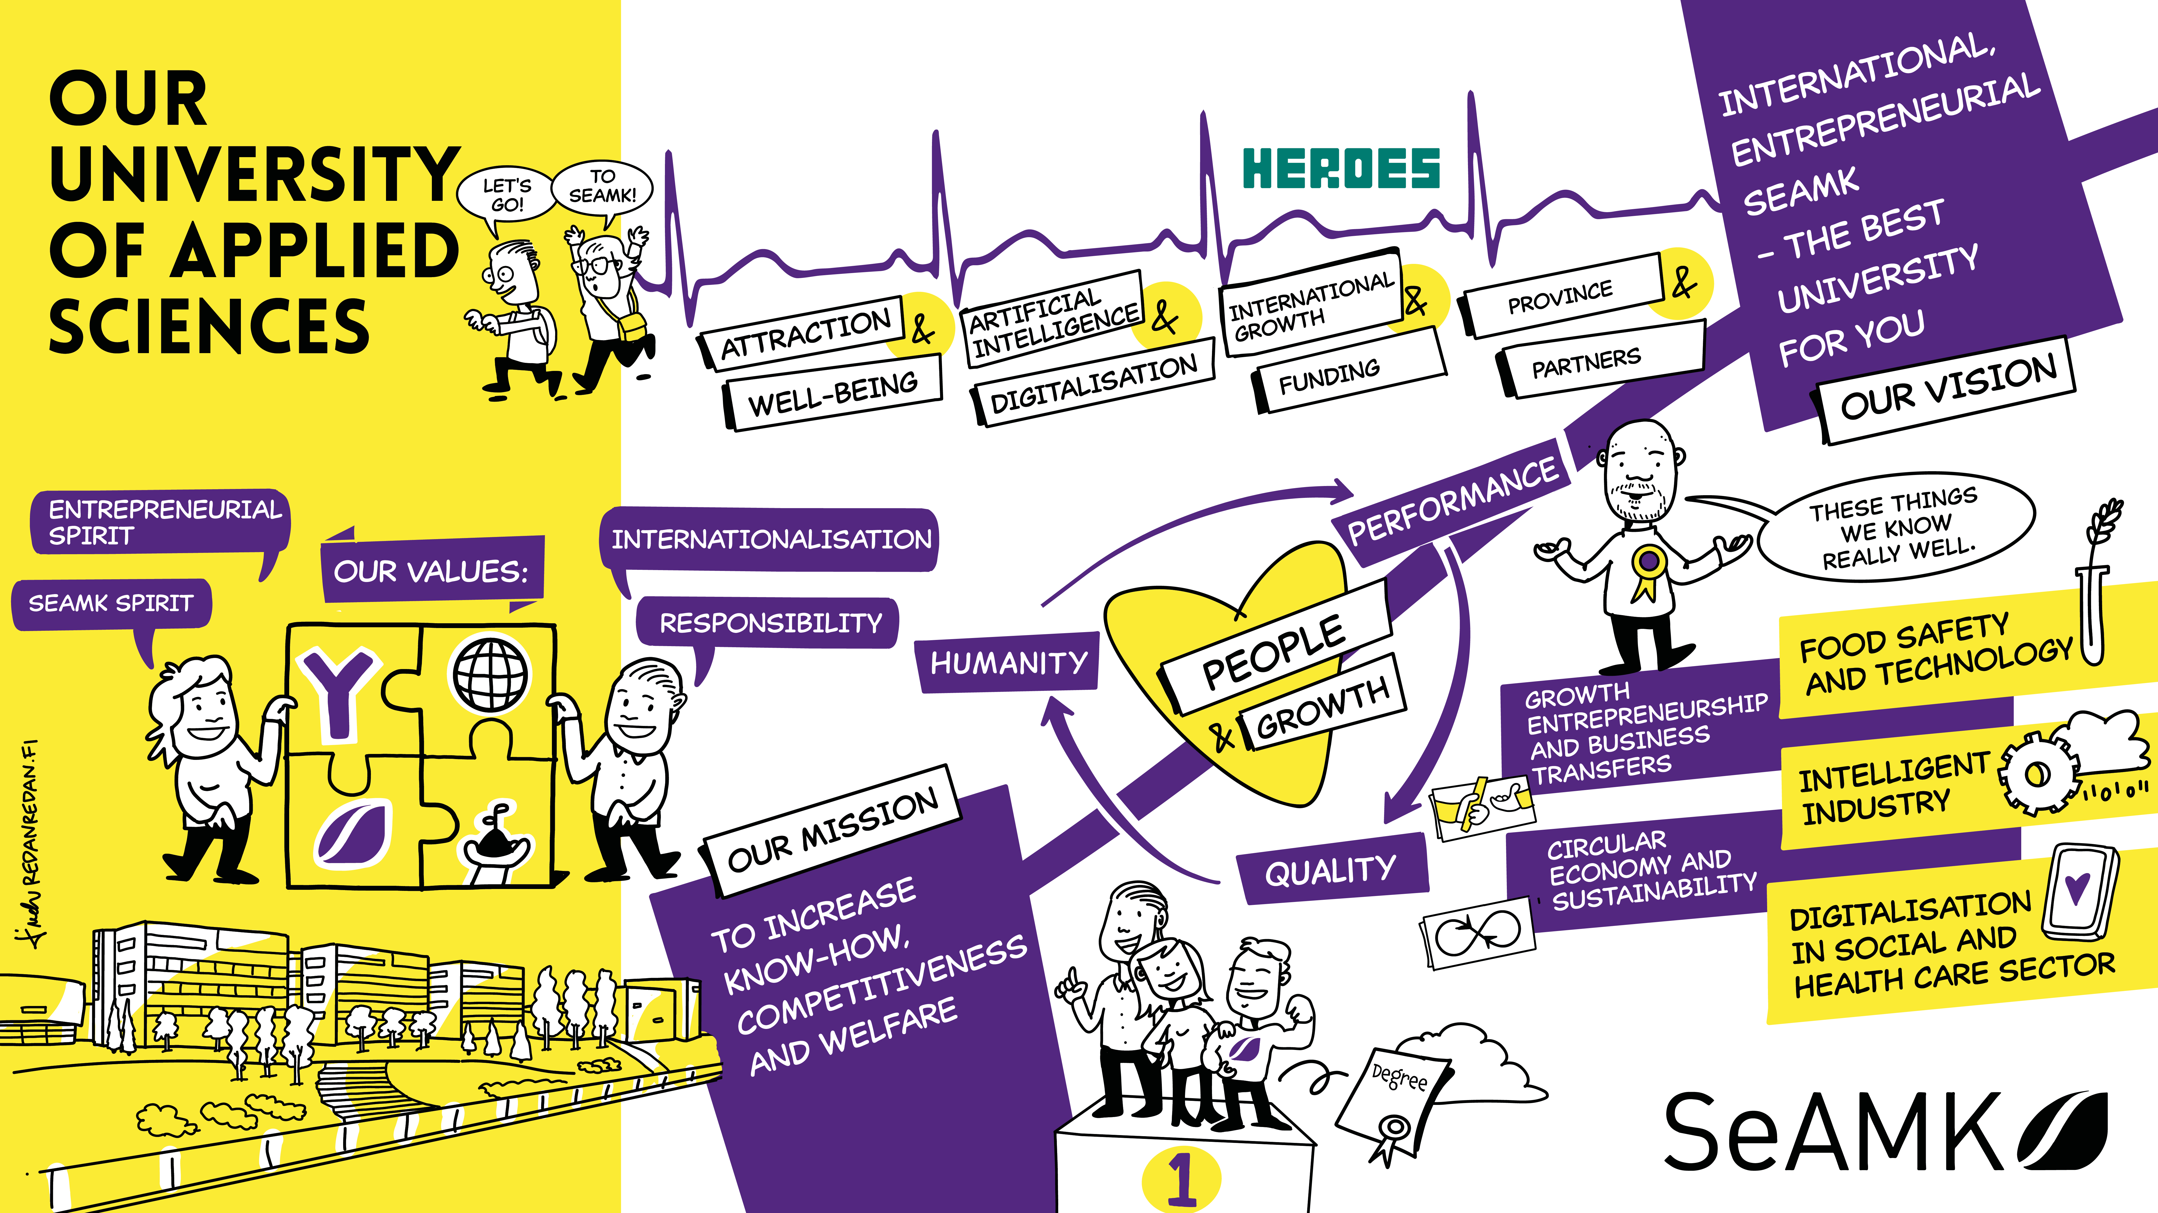
Strategy map

Slide 12
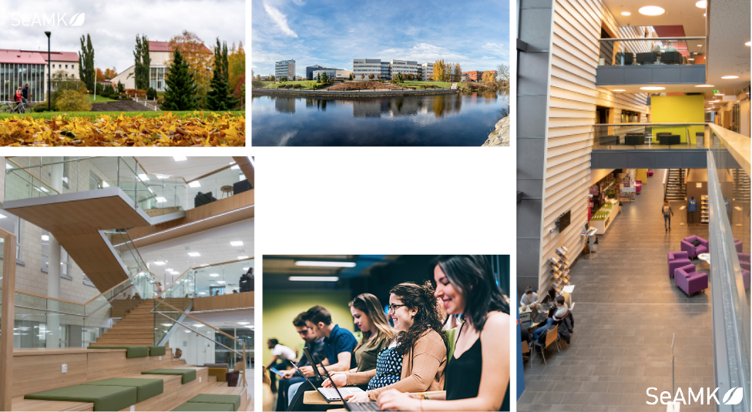
SeAMK Campus

Slide 13
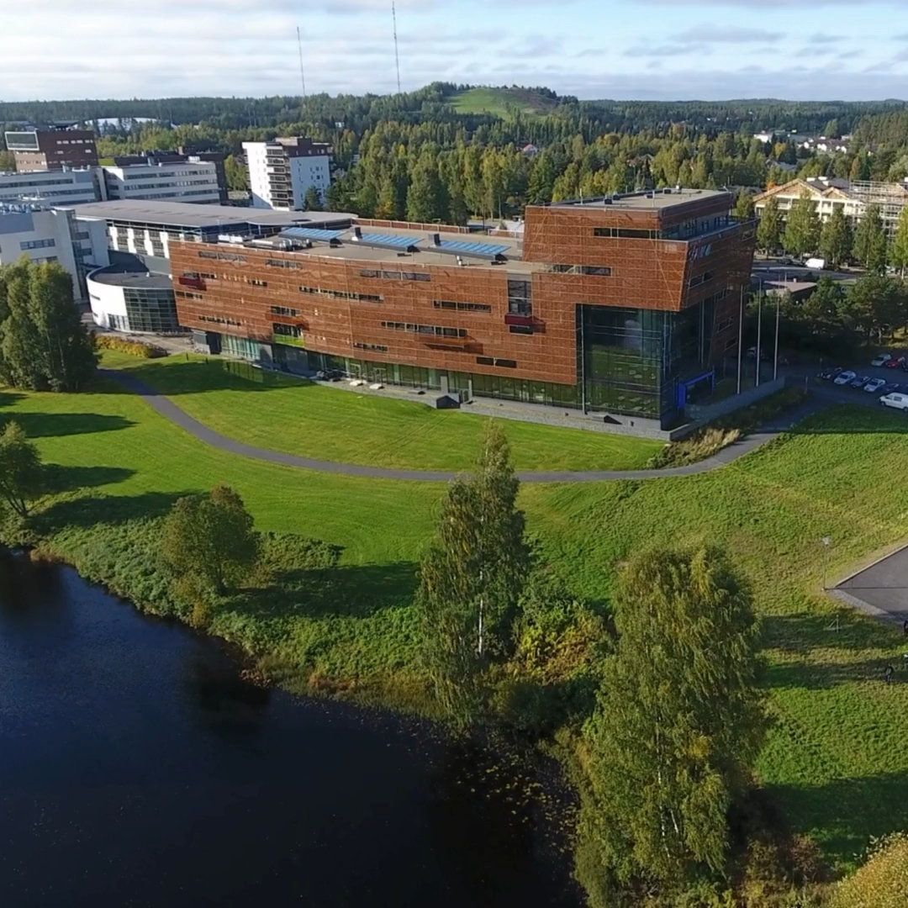
Education in six fields
X

Slide 14
Business and Culture
Altogether approx. 1 500 students​
Bachelor Degree Programmes​
Business:
Business Management​
SME Business Management​
International Business (in English)​
Library and Information Services
Culture:
Cultural Management:​ Media, Event and Visual Management​
Master Degree Programmes​
Business:
Business Competence
International Business Management​ (in English)​

Slide 15
Food and Hospitality & Natural Resources​
Altogether approx. 800 students​
​Bachelor Degree Programmes​
Food and Hospitality:
Hospitality Management (also in English)
Food Processing and Biotechnology​ (Food Technology, Meat and Prepared​ Food Technology)​
Natural Resources:
Agriculture and Rural Enterprises
​Master Programme​
Natural Resources:
Food Chain Development
​Short Programmes:​
From Field to Fork​

Slide 16
Health​ Care and​ Social Work​
​Approx. 1200 students​
Bachelor Degree Programmes​
Applied Gerontology
Nursing​ (also in English)
Public Health Nursing​
Physiotherapy​
Social Work​
​Master Programmes​
Applied Gerontology
Social Work​
Social and/or Health Care Services, Development and Management (in English)
Advanced Clinical Practitioner

Slide 17
Technology
Approx. 1 500 students​
Bachelor Degree Programmes​
Agri-food Engineering (in English)
Automation Engineering (also in English)​
Construction Engineering (Building Construction)​
Mechanical Engineering (Automotive and Work Machine Engineering,​ Mechanical and Production)​
Information Technology (Data Network ​Technology, Software Engineering,​ Embedded Systems)​
​Master Programmes​
Construction Engineering​
Technology Competence Management​
Automation Engineering

Slide 18
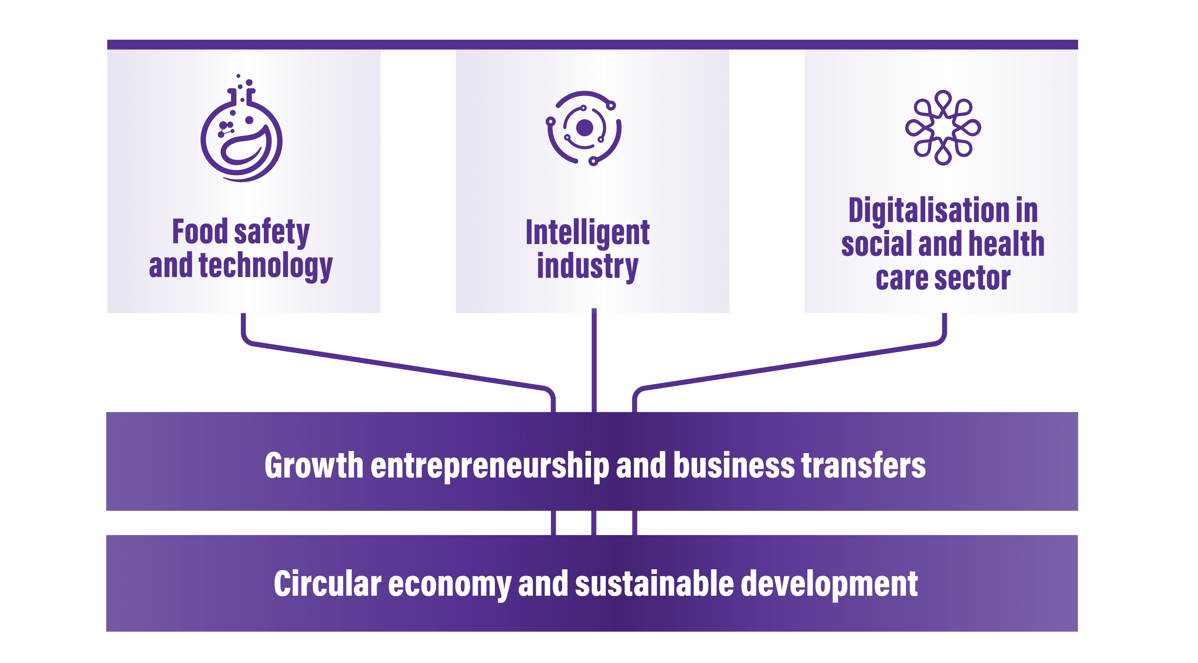
SeAMK’s profile areas in research, development & innovation (RDI) and education

Slide 19
SeAMK’s international activities 1/2
About 200 partner universities in about 50 countries​.
International strategic networks​.
Around 15 double degree agreements in the fields of business and technology​.
Five bachelor degree programmes​ (Agri-food Engineering, Automation Engineering, International Business, Nursing, Hospitality Management), and two master degree programmes​ (International Business Management, Social and Health Care Services, Development and Management)​ are completely taught in English​.

Slide 20
SeAMK’s international activities 2/2
Half of the students study at one of our international partner universities or conduct​ their practical training abroad.
Exchange programmes in English (30–60ECTS) and intensive courses for international and Finnish students.
Each year around 40% of the staff has a​ mobility period abroad.

Slide 21
Exchange programmes 2/2 For the students of the partner institutions of SeAMK
Technology​
Professional Studies in Automation Engineering,​ Construction Engineering, Information Technology and Mechanical​ Engineering at School of Technology (30 to 60 ECTS credits available)

Slide 22
Student activities
Tutoring system
Extracurricular activities
SAMO sports
Student union SAMO and other student associations

Slide 23
Thank you

